Slide 1
Artificial Intelligence Methods (AE2AIM)
Lec. 07: Population Based Metaheuristics II
Dr. Xinan Chen (Room PMB442)
School of Computer Science
The University of Nottingham Ningbo, China
Email: xinan.chen@nottingham.edu.cn

Slide 2
In this lecture
More on Population based metaheuristics
GA Parameters and Extensions
Applications
Medical text classification
Container Transportation

Slide 3
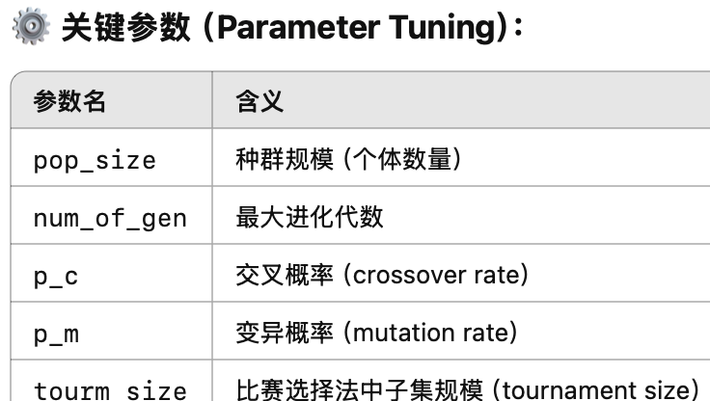
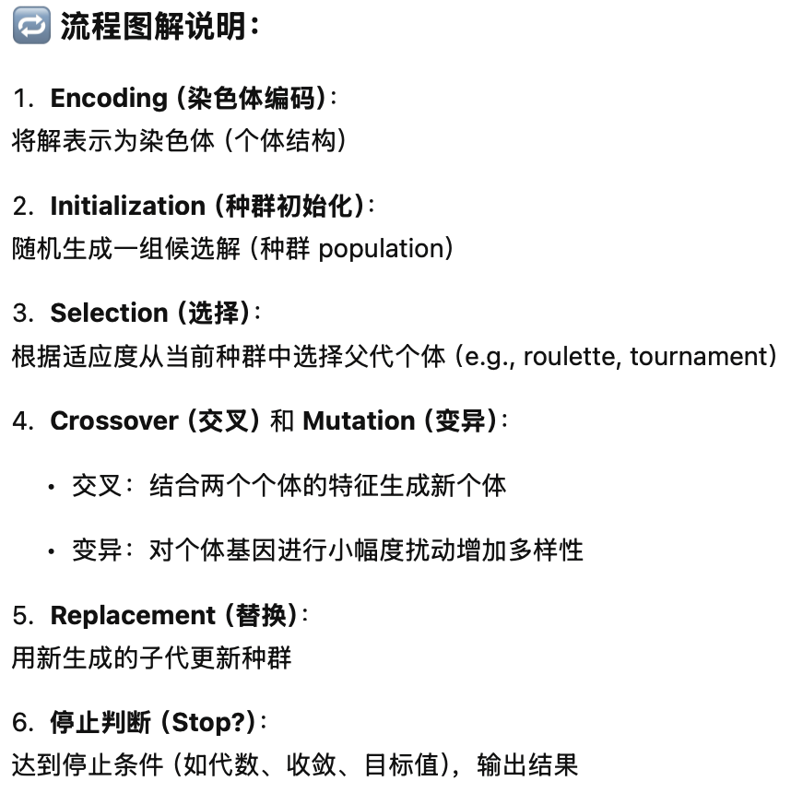
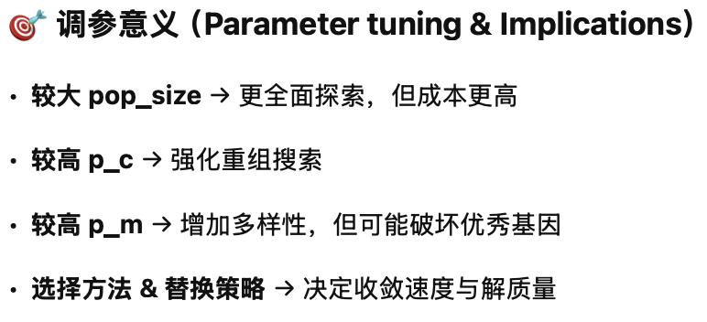
Summary of EA & Parameter Tuning
Imulates natural evolution process
Some important decisions to make
Encoding/decoding, Selection method, Crossover/mutation, Replacement, etc.
Each stage has parameters. Main parameters are:
pop_size
num_of_gen
p_{c} , p_{m}
tourm_size
Parameter tuning & Implications…
Encoding
(Chromosome)
Decoding
initialisation
Population
Stop?
fitness
selection
Mating pool
Output
Crossover
Mutation
Children
replacement

Slide 4
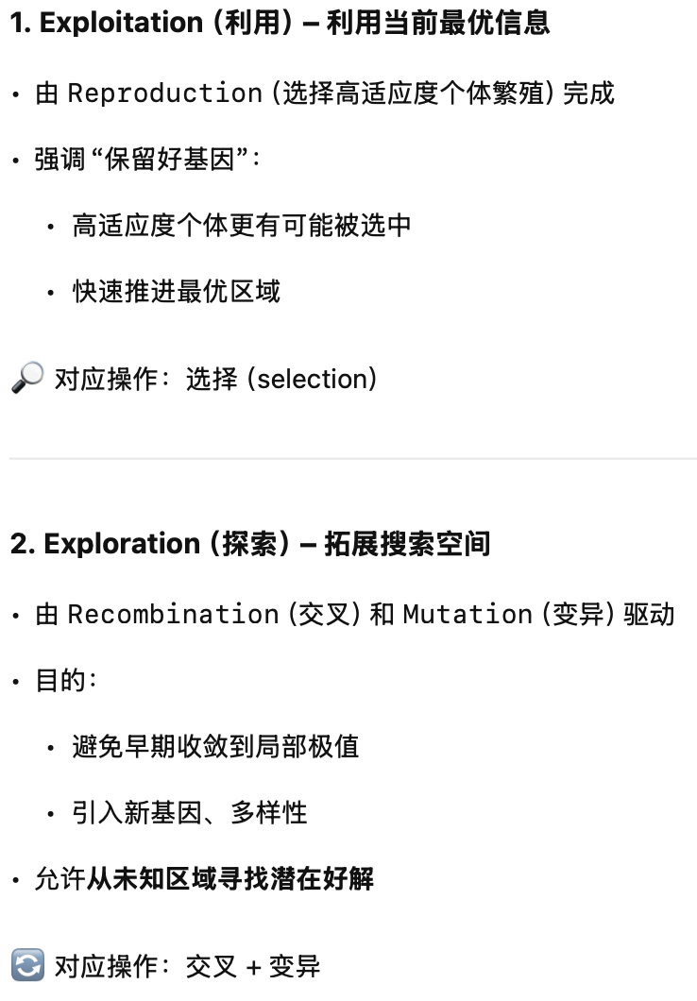
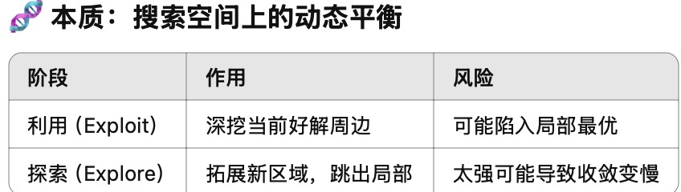
EAs – Features (I)
避免陷入局部最优解
Avoid converging to local optima
Use exploration of the search space and exploitation of promising areas.
Reproduction focuses on high fitness individuals, thus exploiting (EXPLOITATION) the available fitness information.
Recombination and mutation perturb those individuals, providing general heuristics for EXPLORATION. Through recombination operators, reach better solutions by combining already found good solutions

Slide 5
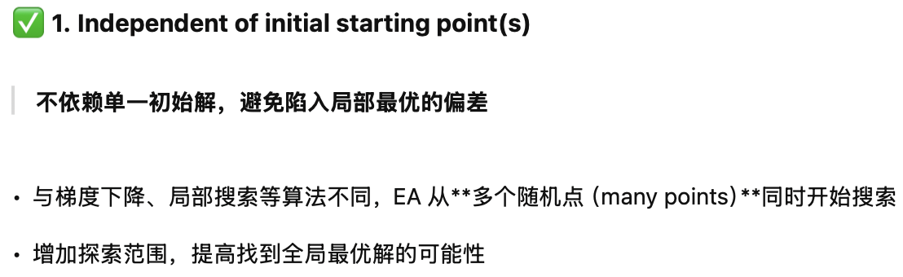
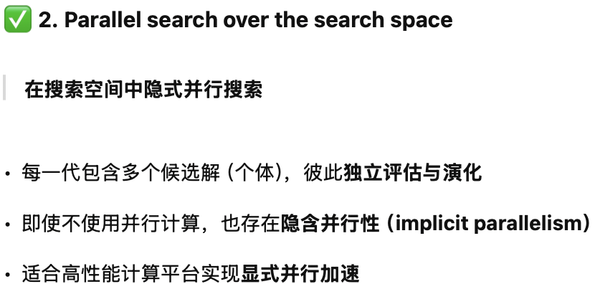
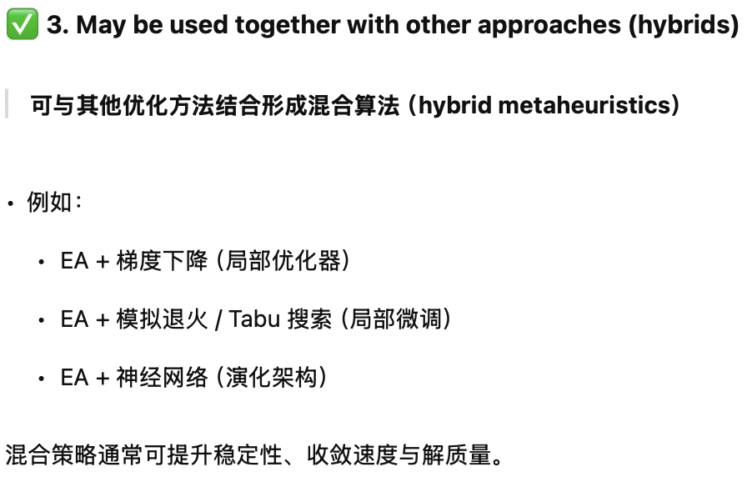

EAs – Features II
Be independent of initial starting point(s)
Start search from many points in the search space
Conduct search in parallel over the search space
implicit parallelism
May be used together with other approaches (hybrids)

Slide 6

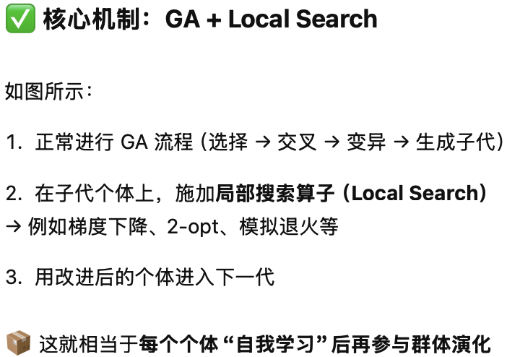

Extensions of GA (1)
Memetic algorithm
GA can be slow in convergency
Natural Evolution takes million years
GA + Local Search
Encoding
(Chromosome)
Decoding
initialisation
Population
Stop?
fitness
selection
Mating pool
Output
Crossover
Mutation
Local Search
Children
replacement

Slide 7
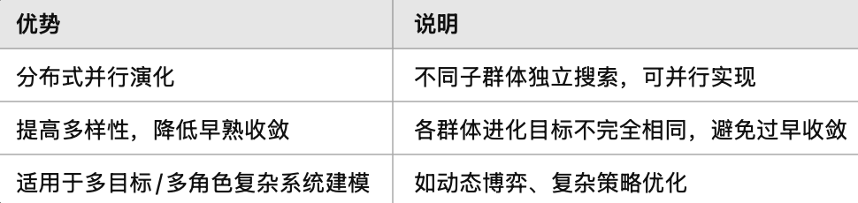
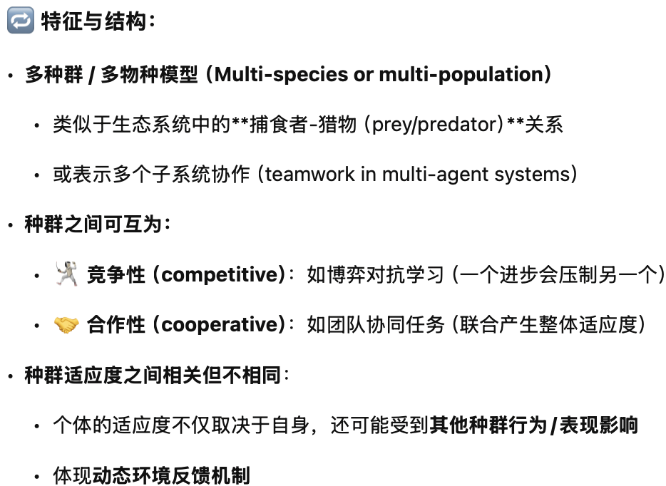
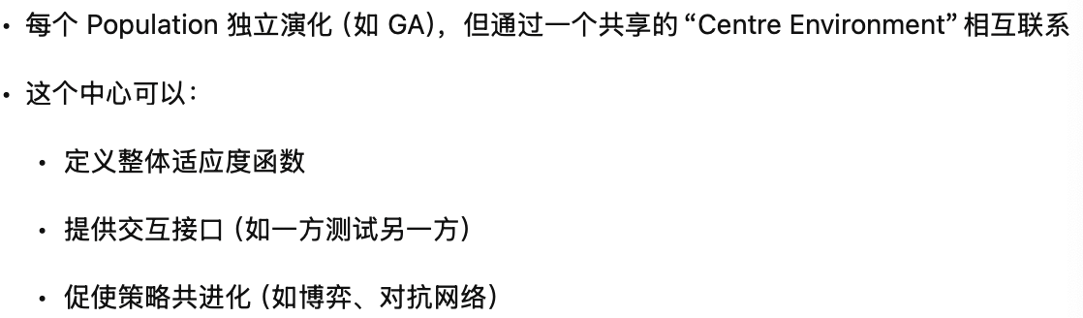
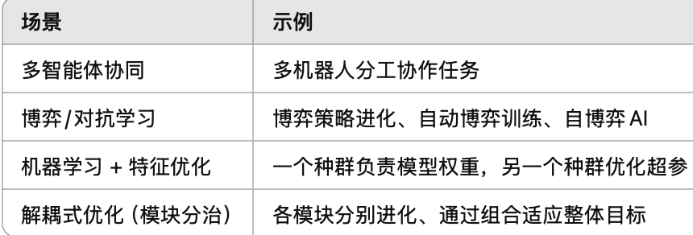
Extensions of GA (2)
Coevolutionary Algorithm
Multi-species/multi-population
e.g. prey/predator
Team works
Populations can be either
Competitive
Cooperative
The fitnesses of populations are closely related but not same.
多个种群（populations）共同进化，适应一个共享或相互影响的“环境”。
Population2
(fitness 2)
Centre Environment
Population1
(fitness 1)
…
Population n
(fitness n)

Slide 8



GP for RegEx Based Medical Text Classifier (1)
减少人工介入
Reduce human-labor action
提高在线问诊容量
Increase online query Capacity

Slide 9




GP for RegEx Based Medical Text Classifier (2)
用户信息 User 主诉Inquiry
智能分诊
Clinic Triage
自动问询 Symptoms Collection
智能问答 Q/A
人工问询 Manual Collection 确诊 Diagnoise

Slide 10
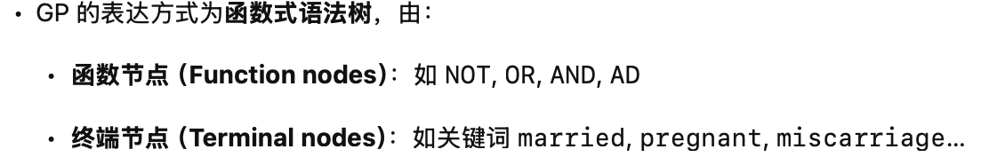
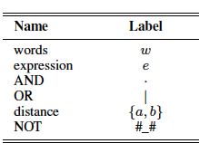
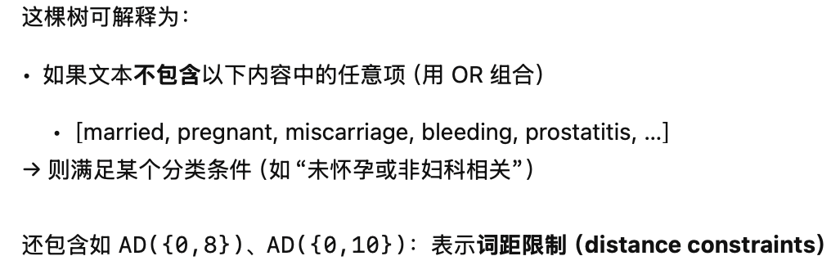
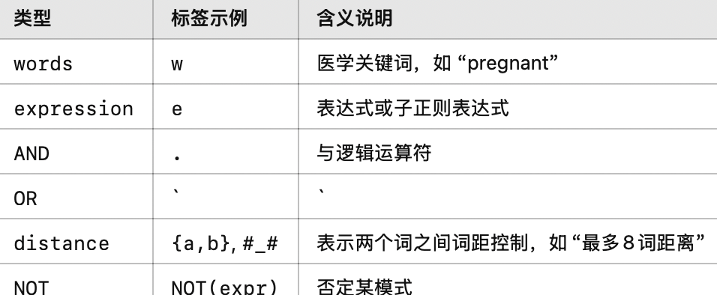
GP for RegEx Based Medical Text Classifier (3)
Solution encoding
GP Tree
GP Functions and Terminals

Slide 11

GP for RegEx Based Medical Text Classifier (4)
Initial Solution – Greedy Heuristic
Menglin Cui, Ruibin Bai*, Zheng Lu, Xiang Li, Uwe Aickelin and Peiming Ge. 2019. Regular Expression Based Medical Text Classification Using Constructive Heuristic Approach. IEEE Access. doi: 10.1109/ACCESS.2019.2946622.

Slide 12
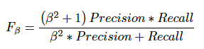
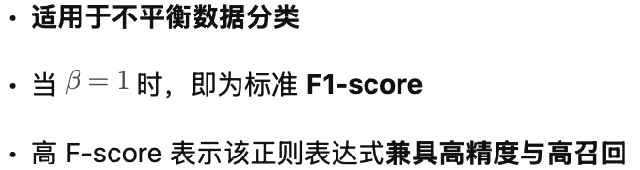
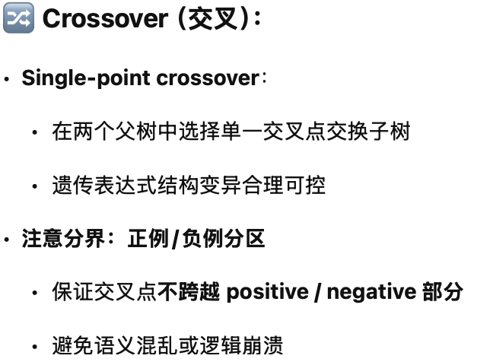
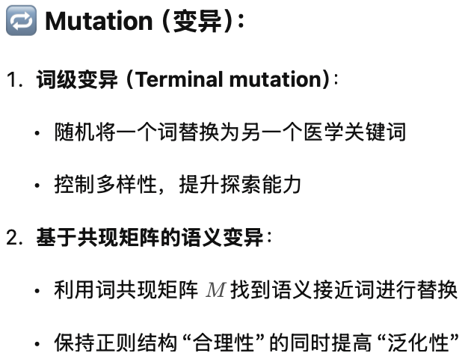
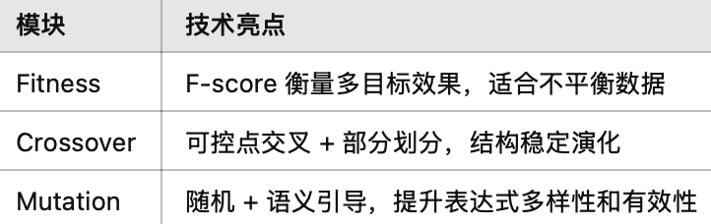
GP for RegEx Based Medical Text Classifier (5)
Fitness: F-score
Crossover
Single point crossover
Seperated between positive part and negative part
Mutation
Randomly replace a termal word with another.
Co-occurance matrix based
J. Liu, R. Bai, Z. Lu, P. Ge, U. Aickelin, and D. Liu, “Data-driven regular expressions evolution for medical text classification using genetic programming,” in 2020 IEEE Congress on Evolutionary Computation (CEC), pp. 1–8, IEEE, 2020.

Slide 13
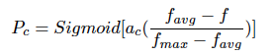
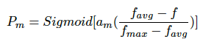
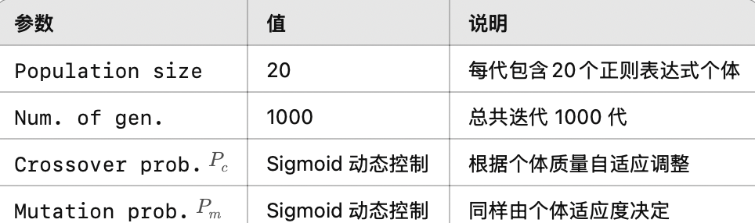
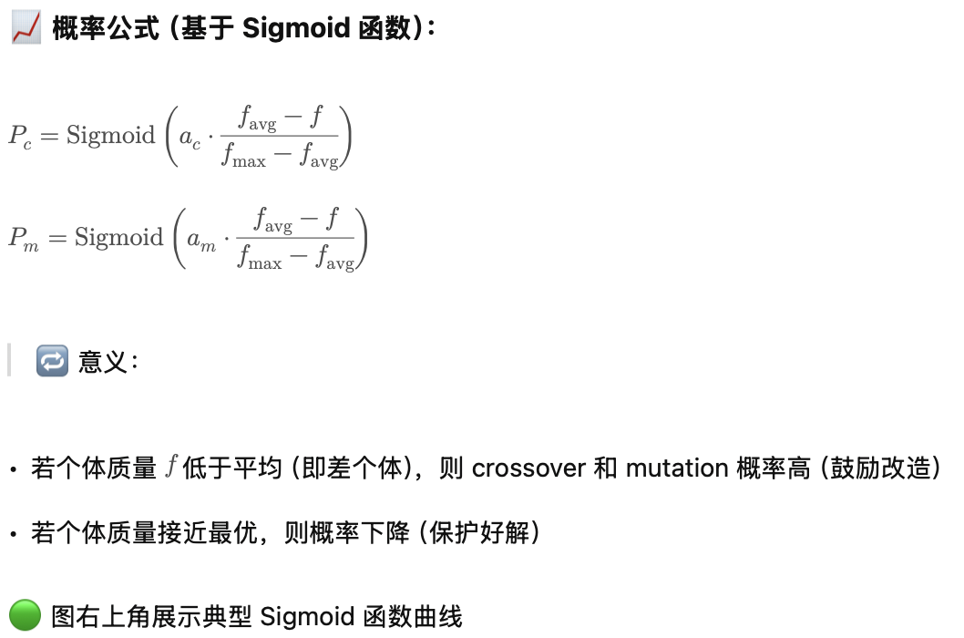


GP for RegEx Based Medical Text Classifier (6)
多个种群（populations）共同进化，适应一个共享或相互影响的“环境”。
Parameters
Population size: 20
Num. of gen.: 1000
Crossover prob:
Mutation prob:
Test instances
a total of 4,634,742 Chinese text records
30 medical categories
A full training takes a day to complete!!!

Slide 14
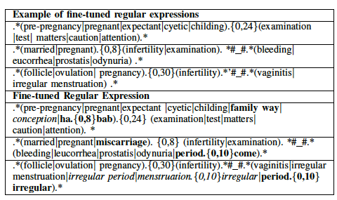
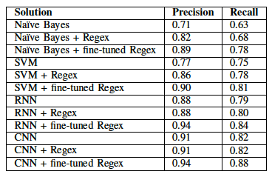
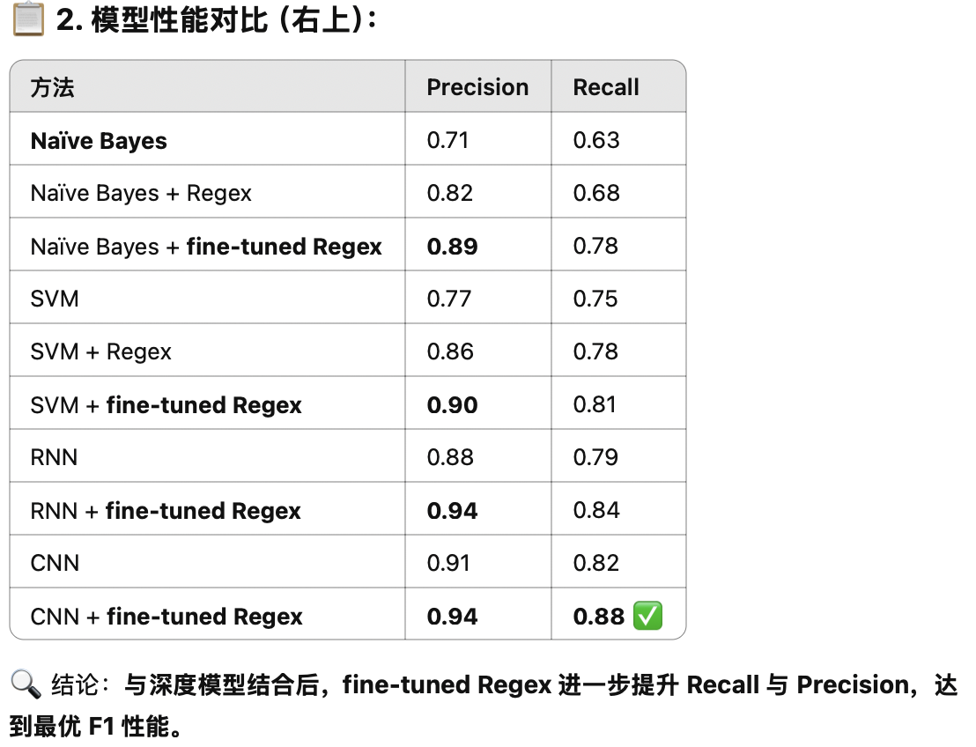
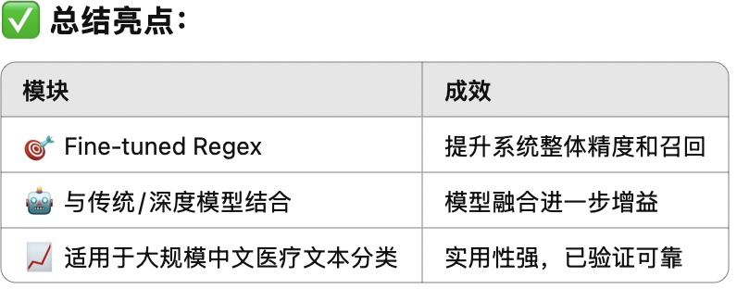
Results

Slide 15
Vehicle Routing Problem

Slide 16
The next lecture
More Evolutionary Algorithms
Ant Colony Opimisation (ACO)
Particle Swarm Optimisation (PSO)

